Slide 1
Esperanza Rising
Virtual Notebook: Chapter 1 - 2

Slide 2
Chapter 1
“Change has not come fast enough, Esperanza. The wealthy still own most of the land while some of the poor have not even a garden plot. There are cattle grazing on the big ranches yet some peasants are forced to eat cats. Papa is sympathetic and has given land to many of his workers. The people know that.” [p. 12]
Key Vocabulary:
wealthy- rich, typically in the form of money.
grazing- to eat.
peasants- people who work in less respectful jobs of there time.
sympathetic- showing a particular feeling for someone.
Based on this description, how would you describe the character traits of Esperanza’s papa? Explain your thinking by recording yourself on this slide.
Place your audio icon in this box!

Slide 3
Sequence the following events into the order in which they happened.
Esperanza sees the wagon in the distance, Alfonso with the reigns and Miguel holding the lantern.
Esperanza wakes of from a dream of her Papa singing.
Papa’s funeral service is held.
Esperanza learned to crochet with her Abuela.
Tio Luis proposes to Mama, so she could be a governs wife.

Slide 4
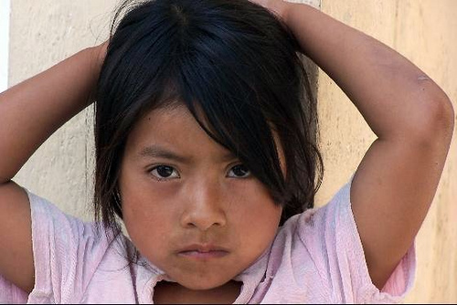
At the end of Chapter 2, Esperanza hugs her doll and thinks to herself, “why did Papa have to die? Why did he leave me and Mama?”
In the textbox to the right, write down how you would respond to Esperanza. Clearly she is upset, how would you help her to heal, what would you say?

Slide 5
Virtual Notebook Rubric: Chapter 1 and 2 of Esperanza Rising!
Task: | 4 points | 3 points | 2 points | 1 point
Slide #1: Audio Recording | Your recording clearly answers the questions that was asked with valid character traits and evidence to support your thinking. | Your recording clearly answers the questions with the use of valid character traits, no evidence was used to support your response. | Your recording expresses invalid character traits based on the passage presented. Evidence may or may not have been used to support the response. | Your recording does not answer the question being asked, task not completed.
Slide #2: Sequence Events | All 5 events have been sequenced in the correct order as depicted in the story. | 4 of the 5 events are placed in the correct sequence as depicted in the story. | 2 – 3 of the five events are placed in the correct sequence as depicted in the story. | 0 – 1 of the five events are placed in the correct sequence as depicted in the story.
Slide #3: Essay Response | Your response is 5+ sentences in length. Your response clearly explains the dialogue you would have with Esperanza about her current situation. | Your response is 4 sentences in length. Your response explains what you would say to Esperanza about her current situation. | Your response is 2 – 3 sentences in length. Your response explains what you would say to Esperanza in her current situation. | Your response is 1 sentence or less. Your response may explain what you would say to Esperanza, but lacks detail. Response may also be off topic.

